Slide 1


I’M LOOKING FOR EXISTING DATA
Data that can be quickly obtained
I NEED TO COLLECT NEW DATA
Field data collection; web scraping
I NEED TO MANAGE DATA
Licensing, privacy, storage, cataloguing, building client governments’ capacity
I NEED INSIGHTS FROM DATA
Data science, app development, sector advisory
DEVELOPMENT DATA HUB
DIME
ITS GEOLAB
GEMS
Open, survey, & geospatial data
DEC
ANALYTICS & TOOLS
Manages subscription to commercial survey app
LICENSING
LEGIA
GEOSPATIAL
Interactive map data visualization
DEC
ANALYTICS & TOOLS
FCV – geospatial data analysis
CATALOGUES
WBG
LIBRARY
SURVEYS
GOST
WB-managed data search portals
Purchased data & subscriptions
WB-supported field survey solutions
Manages WB tablet survey application
Open source and WB standard license procedures
Licensing advisory
WB-managed data search portals
Remote
sensing; network modeling; machine learning
Geospatial research and indices
OFFICE OF INFO SECURITY
KIDS
GFDRR
AG OBSERVATORY
ITS RAPID
APP DEV TEAM
Static map data visualization
Risk modelling and machine learning for exposure mapping
COMPANY
DATA
AWARE weather data subscription
NEW MOBILE APPS
ITS
INNOVATION
& TECH
In-house app development team
(production)
PRIVACY & SECURITY
DATA
PRIVACY OFFICE
Security advisory and accreditation
DATA VISUALIZATION
ITS
RAPID APP DEV TEAM
DEVELOPMENT
DATA PARTNERHSIP
DEVELOPMENT DATA HUB
3rd Party Data Partnerships (e.g., Facebook, Waze)
Design and test new applications
In-house app development team (prototypes)
WB Data Privacy Policy; data security classifications
WB data privacy policy
DIGITAL
DEVELOPMENT
Non-geospatial data storytelling
Simple chart / infographic generation
KIDS
In-house web and mobile app dev team
Staff apply on-line for access
ITS ENTERPRISE
Cybersecurity advisory (for clients)
Enterprise Data Catalog/Data Lake
Simple chart generation
DEC
ANALYTICS & TOOLS
GFDRR
DATA STORAGE
BIG DATA ANALYTICS
BIG DATA PROGRAM
DIME
Data scientists; AI
SENSING + GEOSPATIAL
GOST
ITS
GEOLAB
REMOTE SENSING
GOST
Remote sensing and drone applications for community mapping
ITS
INFRASTRUCTURE
Manages remote sensing partnerships + subscriptions
Manages ESRI Living Atlas catalogue subscription
Large data storage for in-house use
AWS and on-premise solutions
ITS
ENTERPRISE
Machine Learning, Mobile Analytics, Text Data
Data scientists; big data
ITS
INNOVATION
& TECH LAB
Pre-Collected Satellite, LIDAR, Radar, Street View + Curated Geospatial Layers
Remote Sensing Data Procurement; Drone Pilots
Manages remote sensing partnerships + subscriptions
Manipulating large non-geospatial datasets on servers
DEVELOPMENT
DATA PARTNERHSIP
TRANSPORT
Azure solutions
SOCIAL DEVELOPMENT Indonesia
Support for staff using DDP data
ITS DATA
SCIENCE TEAM
Data scientists and app developers; AI + block chain
WBG
LIBRARY
RoadLab Pro – road surface conditions
UNLICENSED DATA
Manages data service subscriptions and purchases
SECTOR SERVICES
GEMS
DATA SHARING
ML Allgorithms and Social Media Insights
DIY data science resources and advisory
GOST
FCV – geospatial data collection training
AG OBSERVATORY
LEGIA
ITS ENTERPRISE
Can’t find what you’re looking for? Request new data partnership, subscription, and/or purchase
Manages remote sensing partnerships + subscriptions
Apps and client training services
Systems to support in-house collaboration on data analytics
Licensing advisory
UNIVERSITY
PARTNERSHIPS
Big Data and ML/AI solutions
DEVELOPMENT
DATA PARTNERHSIP
App –trend analysis & advanced analytics
DEVELOPMENT DATA HUB
POVERTY
Working with data science students
University partnerships on behalf of WB
Request new partnership
SWIFT and EAP Poverty Portal tools to measure poverty
ITS
ENTERPRISE
Add data to the catalogue
ENERGY
DIME
API + authentication advisory
SECTOR
COLLECTIONS
Energy.info;
Electrical grid maps
APIs
DEC
ANALYTICS & TOOLS
Manages subscription to commercial survey app
ITS RESOURCES
ITS INFRASTRUCTURE
GP-Curated
Data Sets
AGRICULTURE
Identifying and using web APIs to pull data
GOVERNMENT
CLIENTS
Server and data science environment resources
AWS and on-premise solutions
Living Standards & Measurement Study (DEC); AG Observatory
Manages WB tablet survey application
DEC
ANALYTICS & TOOLS
ITS
ENTERPRISE
TRANSPORT
Client capacity building resources
Manages WB Github Repositories
SOCIAL DEVELOPMENT Indonesia
Azure solutions; Data science portal
HEALTH
DISASTER RISK MANAGEMENT
SUM4All Program; Road cost database (DEC)
ESF
Predictive Data Analytics
Mathematical models
ENVIRONMENT
App Development/ Human Centred Design in Development
TRANSPORT
WATER
City Resilience Program - City Scan
GFDRR - Disaster Risk Profiles
Wealth, ANS, Hidden Dimensions of Poverty
ESF ISU develop ESF indicators
ITS
RAPID APP DEV TEAM
SECTOR SERVICES
Community Development and Early childhood data
POVERTY
GENDER LABS
DRIVER, Road Safety Assessment, HDM5
URBAN
Lab Lead connectors program
Data4Goals -
Micro Data Library
SOCIAL DEVELOPMENT Indonesia
Curated gender data collection
In-house web and mobile app dev team
GEMS
Apps developed and managed by GPs; Sector advisory to support data project
CLIMATE CHANGE
HEALTH
FCV – capacity building
City Resilience Program
Climate Change Knowledge Portal
Community Development and Early childhood data
Curated health data collection

Slide 2







#99D8D9
#B9D1E2
#EBEBEB

Slide 4
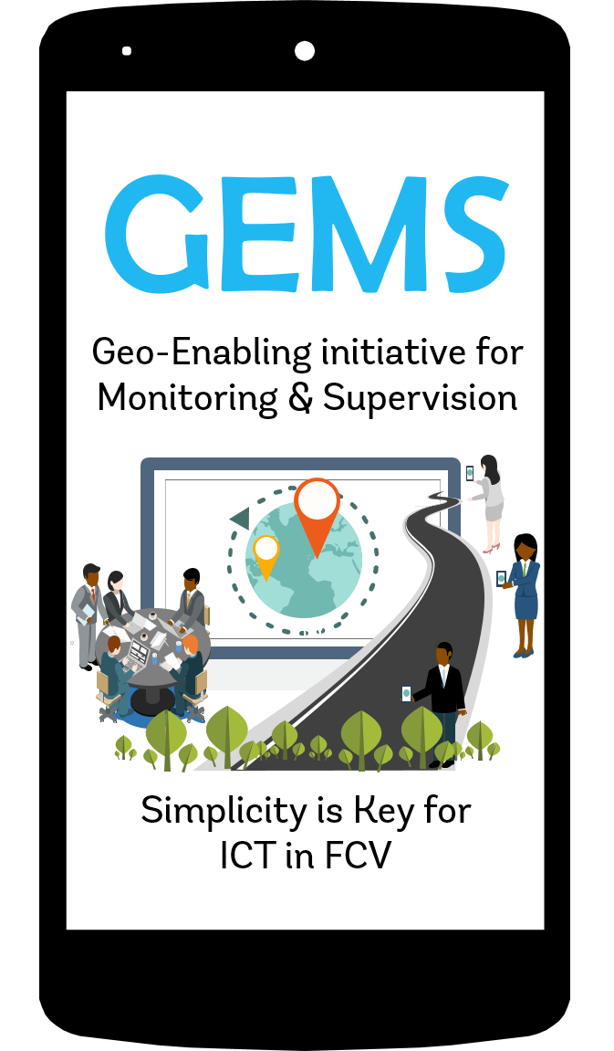


ESF

Slide 5


